Slide 1
PI/QI Journal Club
12MAR19
LCDR Thota
Notes:
Ok everyone, this is going to be my topic for this month’s journal club.

Slide 2
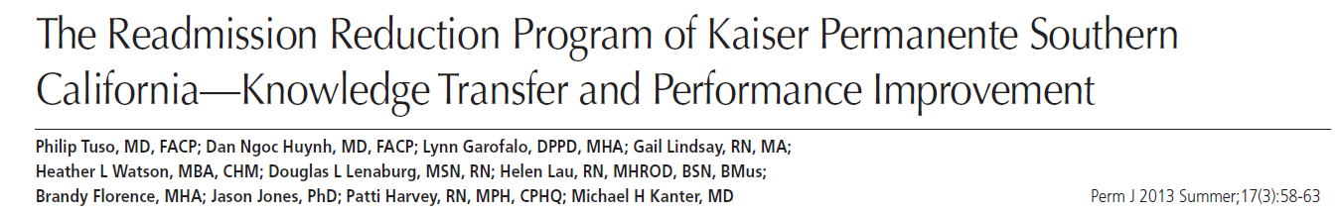
Article to Discuss
Notes:
This is the article that we are going to be reviewing. The Readmission Reduction Program of Kaiser Permanente Southern California- Knowledge Transfer and Performance Improvement. I chose this article because its what I used for Carol’s midterm and PI/QI is still fresh in my mind since that was the focus of her past course for the quarter. This is also the article that I recommended to Arpit for the final.

Slide 3
Overview
Background
Purpose
Methods
Deep Dive
Results
Discussion
Questions
Notes:
Here’s an overview of what we are going to cover for the talk. Background, Methods, Results, Discussion, questions

Slide 4
Background
Early 2000’s, readmissions rising
ACA
Cost, quality, reimbursement focus
Shift from pay for performance
Preventable causes investigated

Slide 5
Background
To meet ACA requirements, KP did systemic eval of process at systems, hospital, doc level
In 2011 - KPNW won an award for its transitional care bundle
Later that year, KPSC was tasked to implement this bundle
KPSC has 13 hospitals and 40,000 Medicare patients in its enrollment

Slide 6
Purpose of this study
KPSC wanted to decrease readmissions by implementing a bundle that their sister organization did
6 elements of the KPNW bundle + 2 more

Slide 7
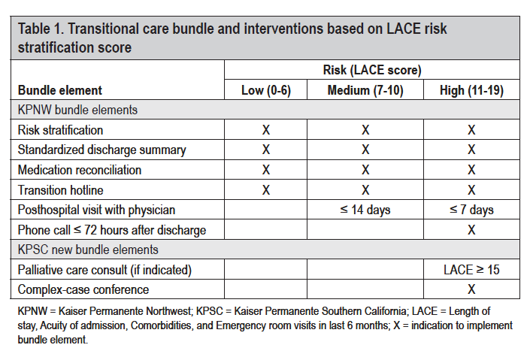
Transition Bundle
Notes:
These are the six elements of the bundle. Risk stratification is based on the LACE score here. It’s length of stay for their previous admit, Acuity is how sick they were on admission, Comorbidities, and # ED visits in the past 6 months.

Slide 8
Method
KPSC created an work group, ISB and implementation team
Work group tested/refined bundle
ISB approved/sponsored bundle

Slide 9
Method
Monthly meetings of the 13 hospitals to review success/barriers of bundle implementation
Implementation team carried out bundle at each site
* Each site given a local resource team to help implementation team
Notes:
The star is the key feautures of implementation where they had a resource where we don’t.

Slide 10
Deep Dive – 8 Bundle Elements
8 bundle elements
Risk stratification (LACE)
Standard D/c Summary
Med Recc
Post D/c Hotline
Post D/c phone call
7 day f/u
Palliative Care Consult
Case conference

Slide 11
1. Risk stratification
LACE - LOS, Acuity, Comorbid, ED visits
Risk for 30 day readmission: Low (0-6), Medium (7-10), High (11-19)
Excluded - peds, OB, vertical transfers, new patients (12 months)
Notes:
Validated in the Kaiser system. They don’t go into details on how they did this

Slide 12
2. Standard Discharge Summary
1. Brief narrative sum
2. Pending labs/rads
3. Incidental findings needing further w/u
4. Med reconciliation
5. DME
6. Referrals
7. Code status

Slide 13
3. Medication Reconciliation
Prior to d/c, reviewed dosing, route, frequency, advesr drug events
Remove 2x meds
Monitor physician med reconciliation

Slide 14
4. Posthospital Discharge Hotline
24-hour phone service for questions at KP San Diego
Nurse advice
Determine need for emergent ED eval

Slide 15
5. Post-hospital Discharge Phone Call
For High Risk LACE d/c
Phone call at 72 hours by RN
Review med compliance
Review ADE
Address social barriers to care

Slide 16
6. Post-hospital Discharge Visit <7 days
PCM follow up in 1 week
All patients

Slide 17
7. Palliative Care Consultation for High-Risk Patients
Purpose: Decrease cost/Decrease readmission
For High risk LACE
Inpatient
Attending discussion w/ patient and family about palliative care

Slide 18
8. Complex-Disease Case Conference
Docs (PCM and specialist)/nurses from all 13 hospitals
Both in/outpatient
Monthly
High risk LACE w/readmits in 6 months
Readmission IHI worksheet
Notes:
IHI – Institute for Healthcare Improvement

Slide 19
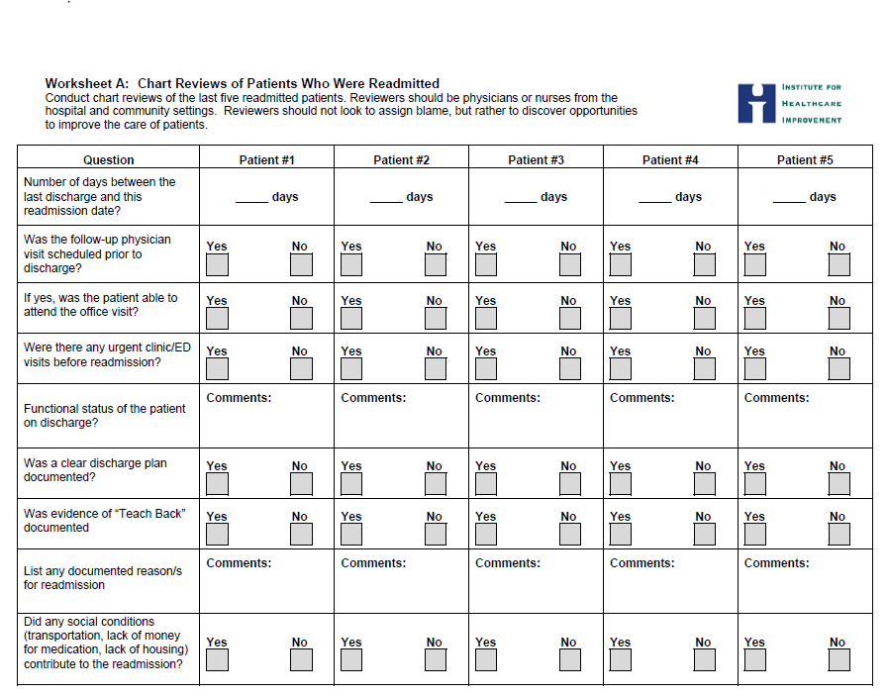

Slide 20
Results
Decrease observed/expected ratio
Decreased total number of readmissions
Decrease total % of readmissions 13%-> 11%

Slide 21
HEDIS
Notes:
Healthcare Effectiveness Data and Information Set

Slide 22
Discussion
Most impactful Social Determinants of Health (SDH)
Can’t pay for meds
Can’t physically get to follow up
Impaired ADL’s (feeding, walking, bathing)
SDH is biggest contributor to readmissions
Biggest bang for buck is time spent prior to d/c

Slide 23
Discussion
Mechanism of Healthcare
8 bundle elements
Context of Healthcare
Social Determinants of Health
Most important

Slide 24
Limitations
QI, no control
Excludes new patients
Ample resources provided with local resources for implementation-> not the same for us
Doesn’t address “lost to follow up”

Slide 25
Conclusion
Bundles work
SDH very important
Future focus will be on addressing SDH
Tailoring d/c process around patient’s ADL’s

Slide 26
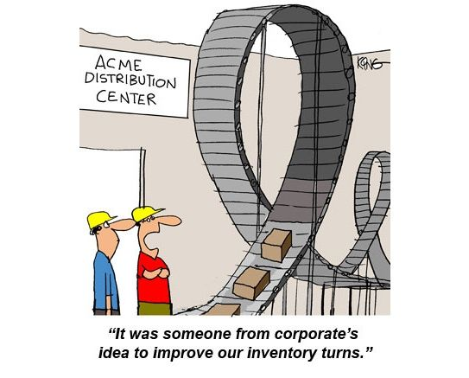
Questions

